Slide 1

Oracle 11g
SQL: Fundamentals I
Filtrado y ordenamiento de datos

Slide 2
Fundamentals I
2.- Restringiendo y ordenando datos
Limitar el número de registros recuperados en una consulta
Ordenar la información obtenida por una consulta
Uso del ampersand para para definir criterios de filtrado y ordenamiento en tiempo de ejecución

Slide 3
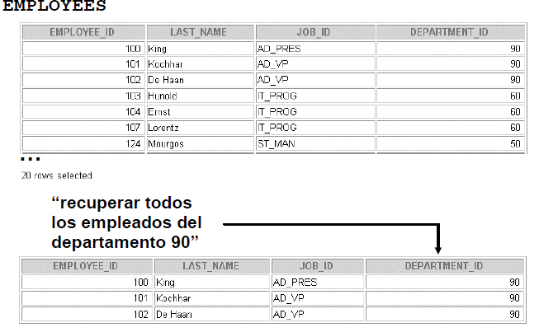
Fundamentals I
Escenario

Slide 4
Fundamentals I
SELECT * { [ DISTINCT ] columna | expresión [ alias ], … }
FROM tabla
[WHERE condición(es)]
Una condición puede estar compuesta de campos, constantes, expresiones y el operador de comparación.
Los tres elementos que integran una condición son:
Nombre de la columna.
Condición u operador de comparación.
Nombre de columna, constante, expresión o lista de valores.

Slide 5
Fundamentals I
SELECT
Employee_id, last_name, job_id, department_id
FROM
Employees
WHERE
Department_id = 90

Slide 6
Fundamentals I
Cadena de caracteres y valores tipo fecha
Las cadenas de caracteres deben ir encerradas entre comilla simple.
En el proceso de comparación la base de datos es sensible a los valores de filtrado.
En el caso de valores tipo fecha el proceso de comparación considera el formato. El formato por default es DD-MON-RR.

Slide 7
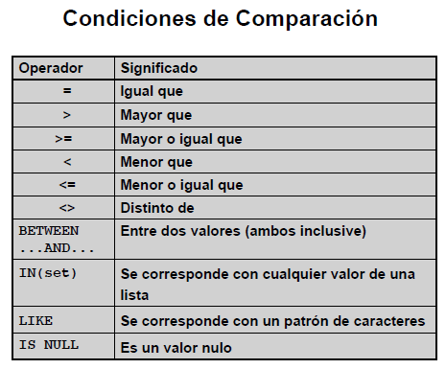
Fundamentals I
Reglas de escritura

Slide 8
Fundamentals I
Select first_name,last_name, salary from employees where salary = 9000
Select first_name,last_name, salary from employees where salary > 9000
Select first_name,last_name, salary from employees where salary >= 9000
Select first_name,last_name, salary from employees where salary <> 9000

Slide 9
Fundamentals I
Select first_name,last_name, salary from employees where salary between 6000 and 9000
Select first_name,last_name, salary from employees where last_name between ‘King’ and ‘Smith’

Slide 10
Fundamentals I
Select first_name,last_name, salary from employees where salary in (4000, 6000, 8000)
Select first_name,last_name, salary, commission_pct from employees where commission_pct is null

Slide 11
Fundamentals I
SELECT first_name FROM employees WHERE first_name like ‘S%’
SELECT first_name FROM employees WHERE first_name like ‘S%’
SELECT first_name FROM employees WHERE first_name like ‘K____’

Slide 12
Fundamentals I
Uso de los caracteres comodín como carácter de filtrado
SELECT
first_name, last_name, job_id
FROM
employees
WHERE
job_id LIKE ‘%SA\_%’ ESCAPE ‘\’

Slide 13
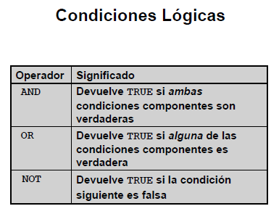
Fundamentals I

Slide 14
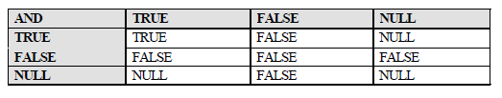

Fundamentals I
Condición AND
Condición OR

Slide 15
Fundamentals I
Select employee_id, first_name, last_name, salary
From employees
Where salary >= 10000
And job_id like ‘%MAN%’
Select employee_id, first_name, last_name, salary
From employees
Where salary >= 10000
Or job_id like ‘%MAN%’

Slide 16

Fundamentals I
Operador NOT

Slide 17
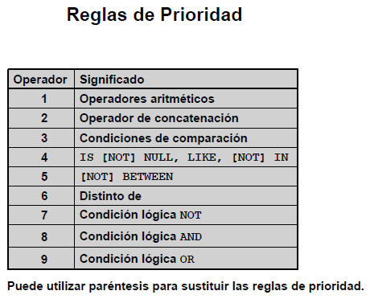
Fundamentals I

Slide 18
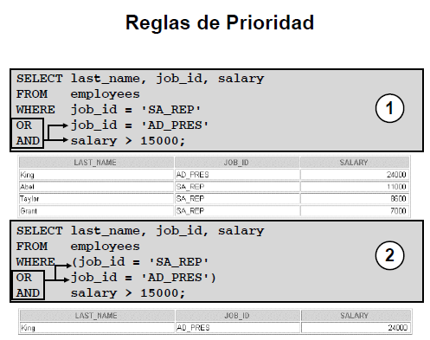
Fundamentals I

Slide 19
Fundamentals I
SELECT * { [ DISTINCT ] columna | expresión [ alias ], … }
FROM tabla
[WHERE condición(es)]
[ORDER BY { columna, expresión, posición} [ASC|DESC] ]

Slide 20
Fundamentals I
Select first_name, last_name, hire_date from employees
Order by hire_date desc
Select first_name, last_name, salary, salary * commission_pct commission
From employees
Order by commission
Select first_name, last_name, hire_date from employees
Order by 3 desc
Select first_name, last_name, hire_date from employees
Order by last_name, 3 desc

Slide 21
Fundamentals I
Select first_name, last_name, salary, commission_pct
From employees
Order by commission_pct nulls first
Select first_name, last_name, salary, commission_pct
From employees
Order by commission_pct nulls last

Slide 22
Fundamentals I
Variables de sustitución
Escenario, se require realizer diversas consultas sobre los empleados de algunos departamentos …
Select first_name, last_name, salary from employees
Where department_id = ‘30’
Select first_name, last_name, salary from employees
Where department_id = ‘40’
Select first_name, last_name, salary from employees
Where department_id = ‘?’

Slide 23
Fundamentals I
Select first_name, last_name, salary from employees
Where department_id = ‘&IdDepartament’
Select first_name, last_name, &campo from employees
Where salary > &salario
Select first_name, last_name, &&campo
From employees
Order by &campo

Slide 24
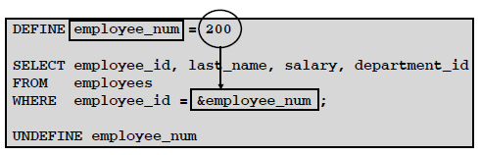
Fundamentals I
DEFINE y UNDEFINED

Slide 25
Fundamentals I
Set verify on
Define department_id_w = 30
Select * from employees
where department_id = &department_id_w
Undefine department_id_w
Set verify off

Slide 26
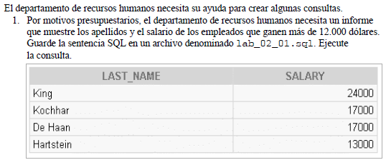
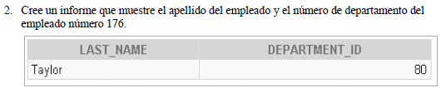
Ejercicios

Slide 27
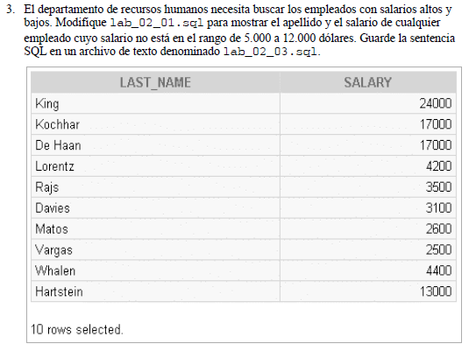
Ejercicios

Slide 28
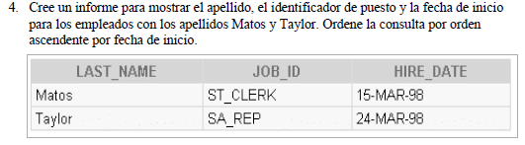
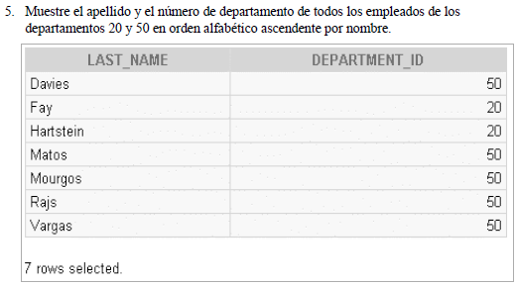
Ejercicios

Slide 29
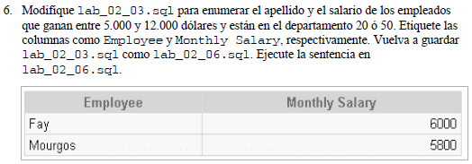
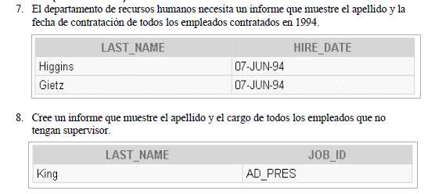
Ejercicios

Slide 30
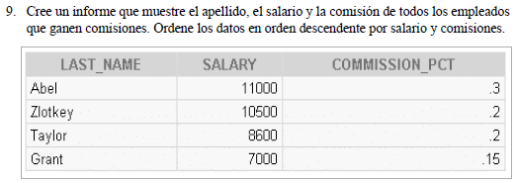
Ejercicios

Slide 31
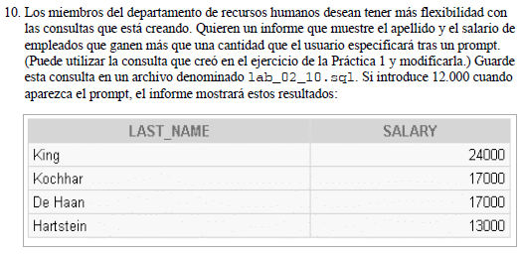
Ejercicios

